Slide 1
Organic and Biochemistry
Chapters 19 and 20

Slide 2
Carbon always has 4 bonds

Slide 3
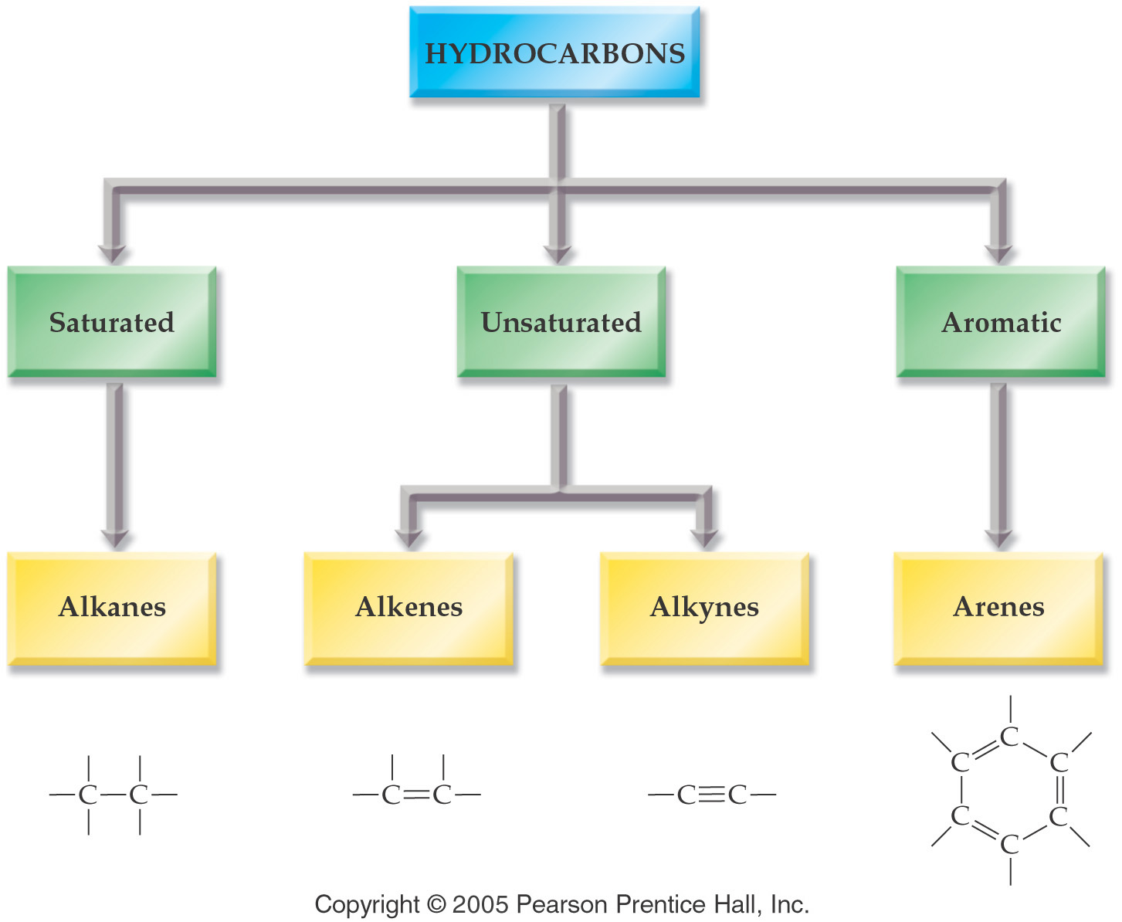

Slide 4
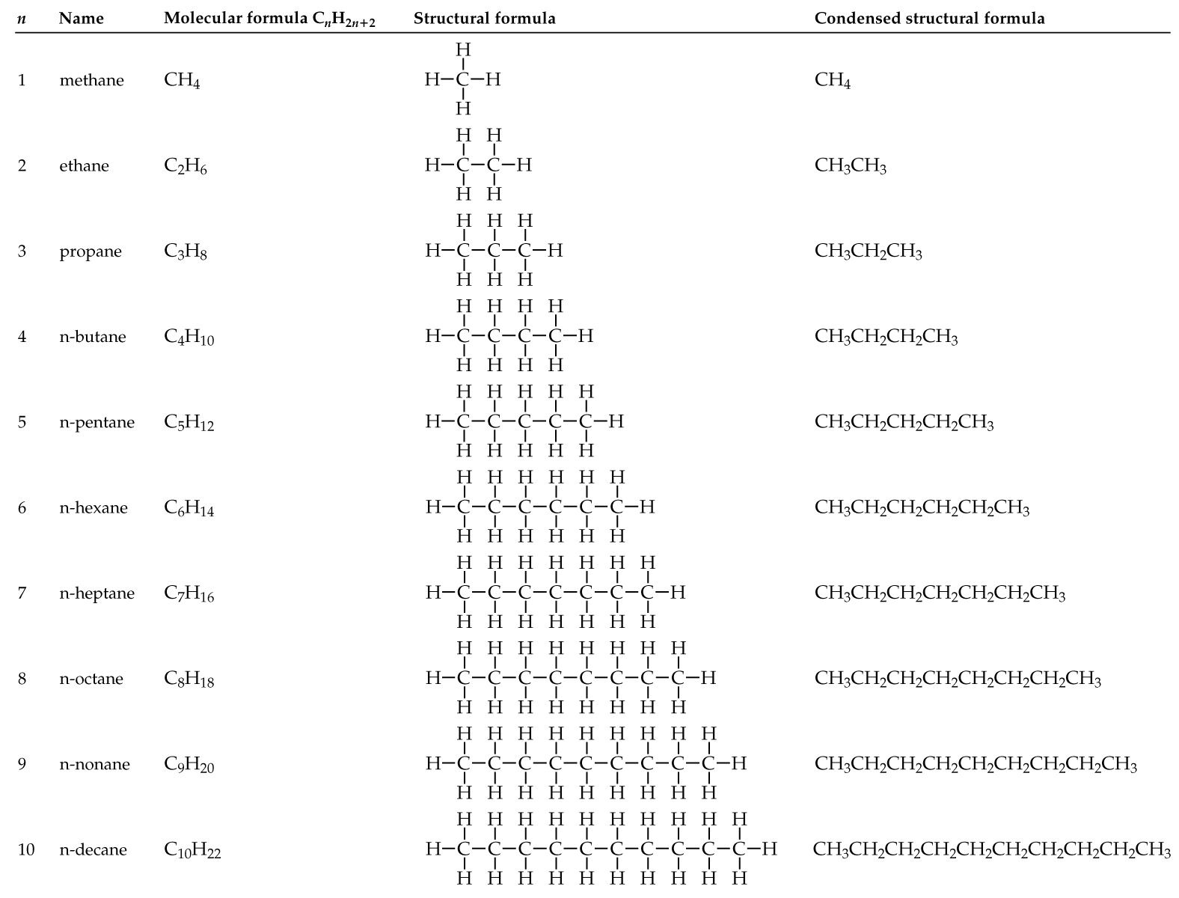

Slide 5
Representing Organic Compounds
Molecular Formula -- C₄H₁₀
Complete structural formula –
Condensed structural formula –
Line formula -

Slide 6
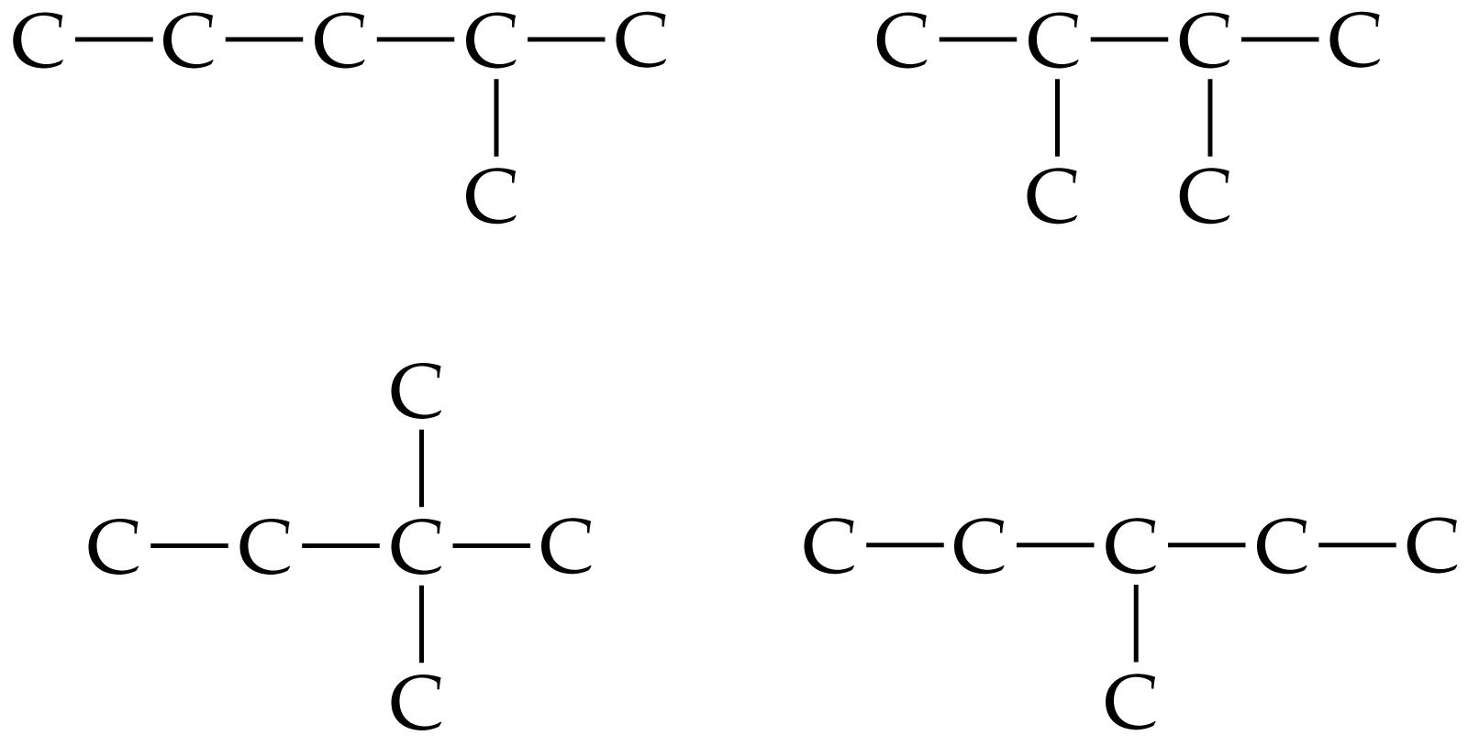
Isomers - Compounds that have the same molecular formula but different structural formulas.

Slide 7
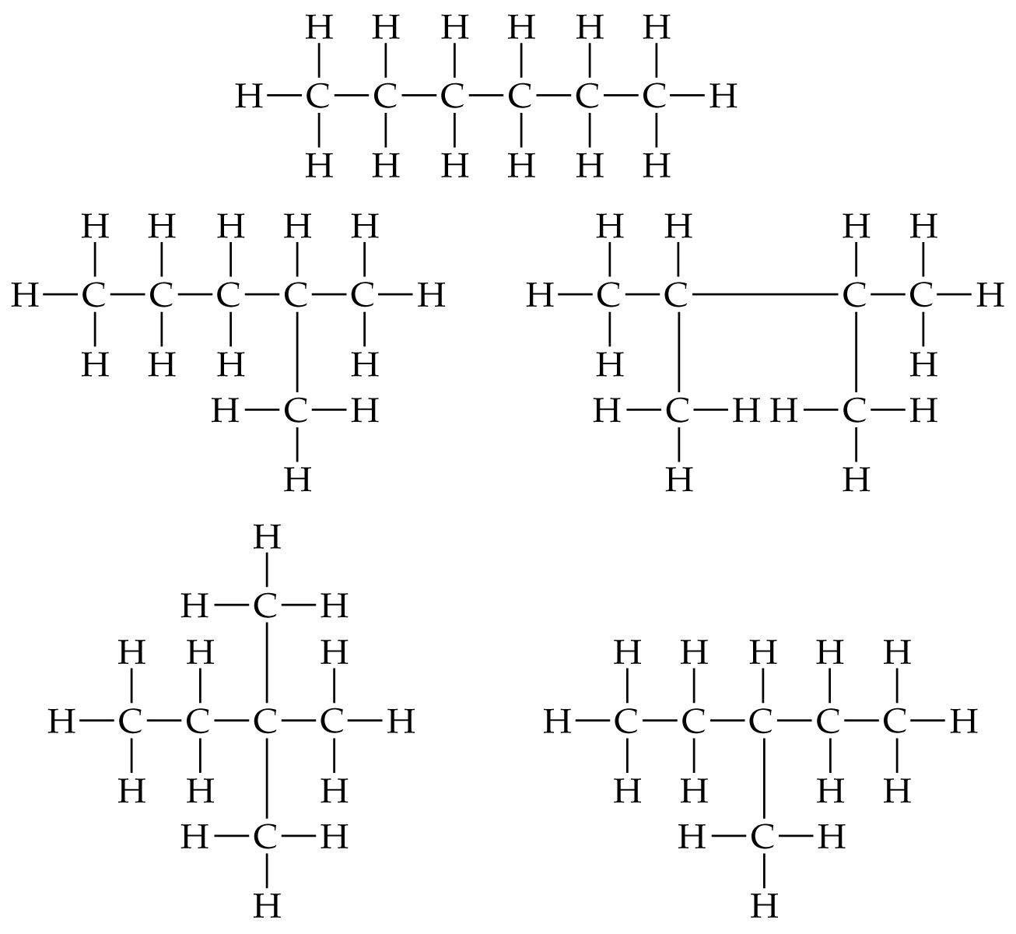
Isomers of Hexane

Slide 8
Nomenclature – alkanes
Find the longest chain of carbon atoms --- this is the base name of the alkane.
Alkyl groups branch off of the main chain
Main chain is numbered to show where alkyl groups are attached.

Slide 9
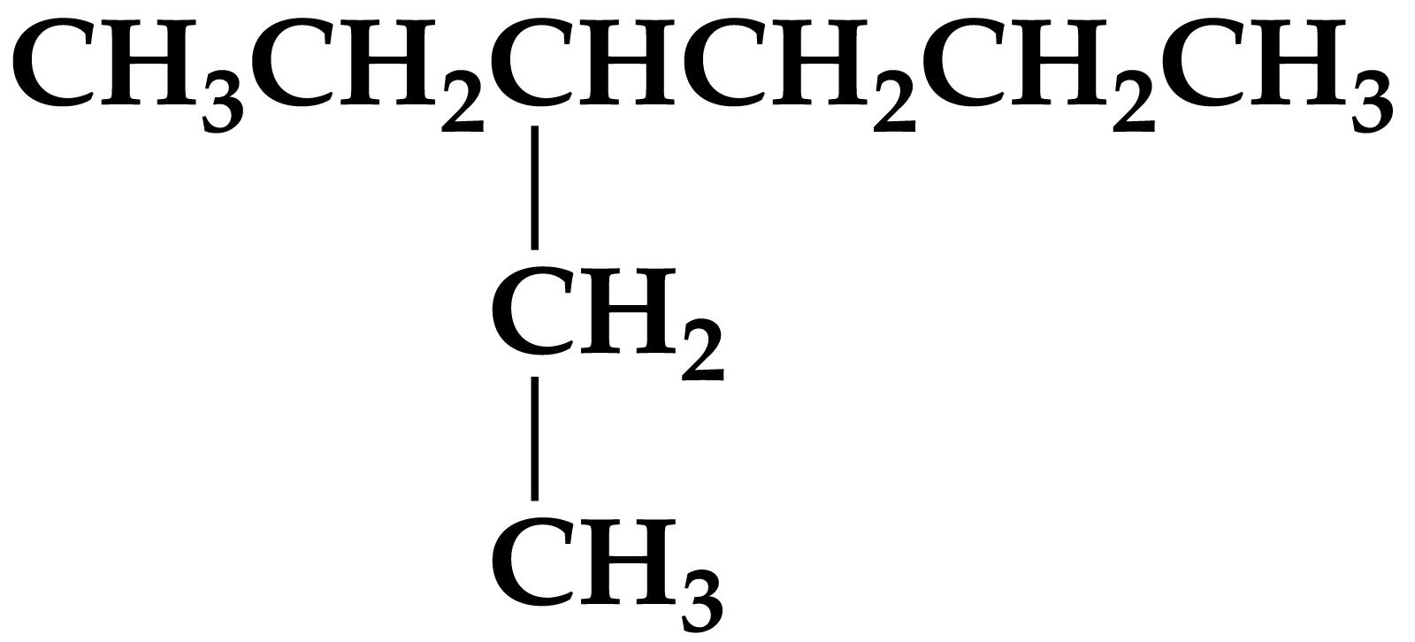
Name this compound

Slide 10
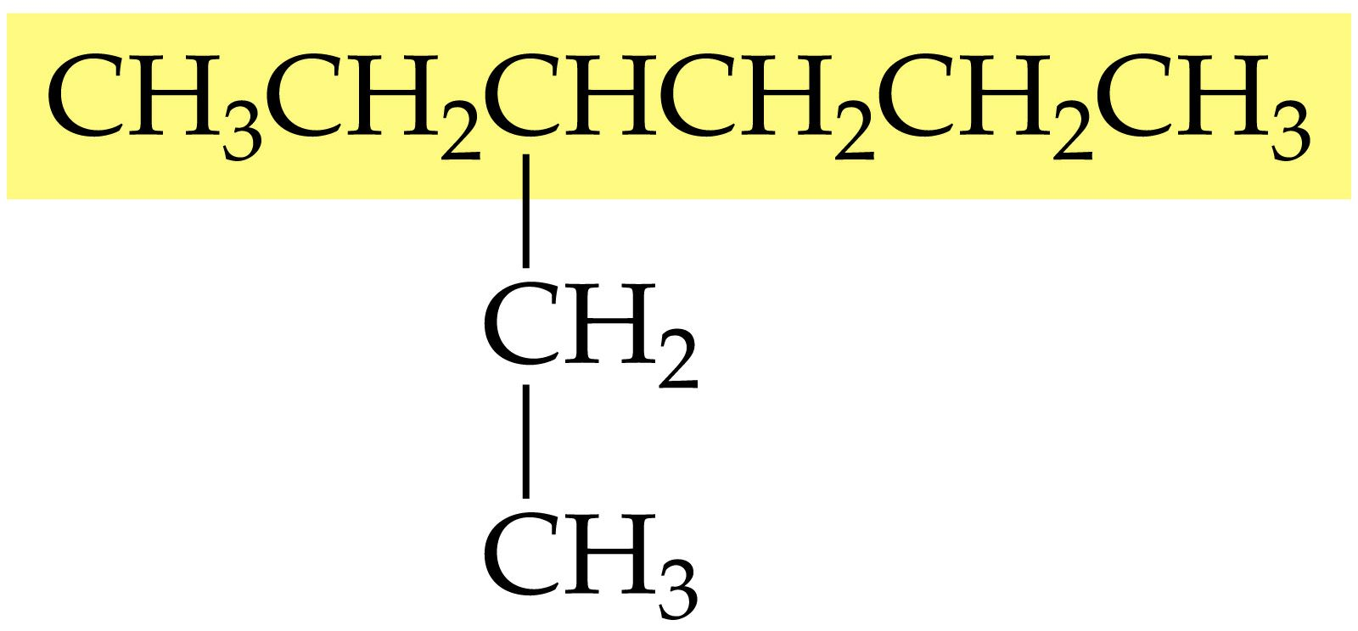
Longest chain highlighted

Slide 11
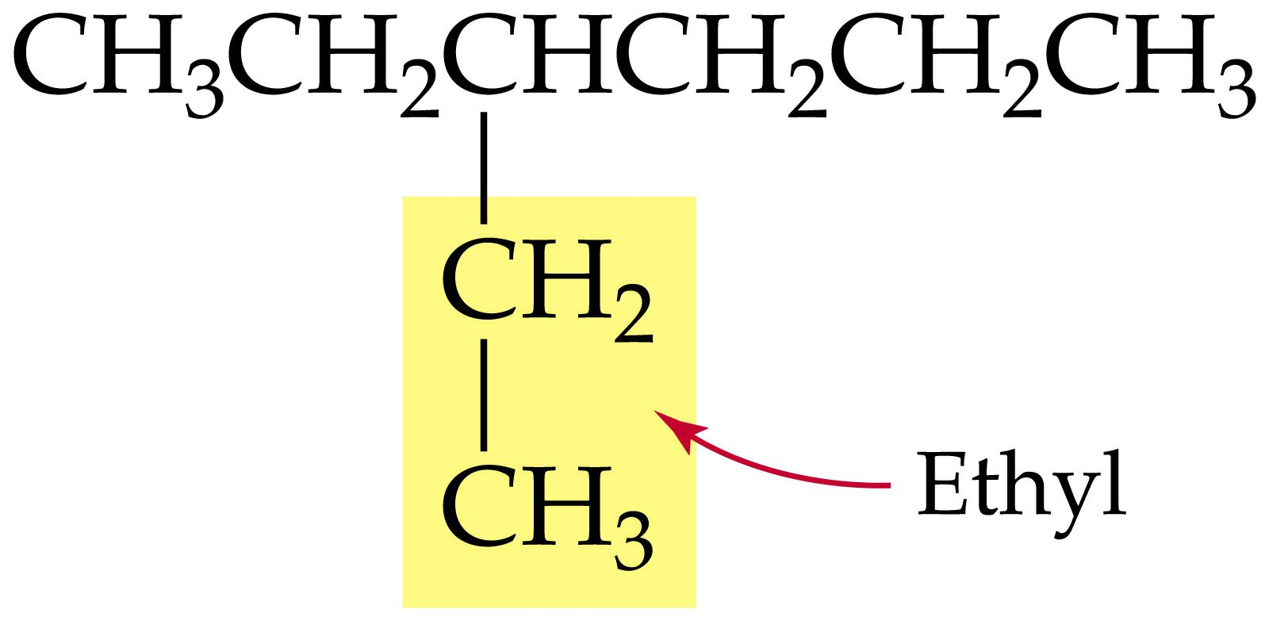
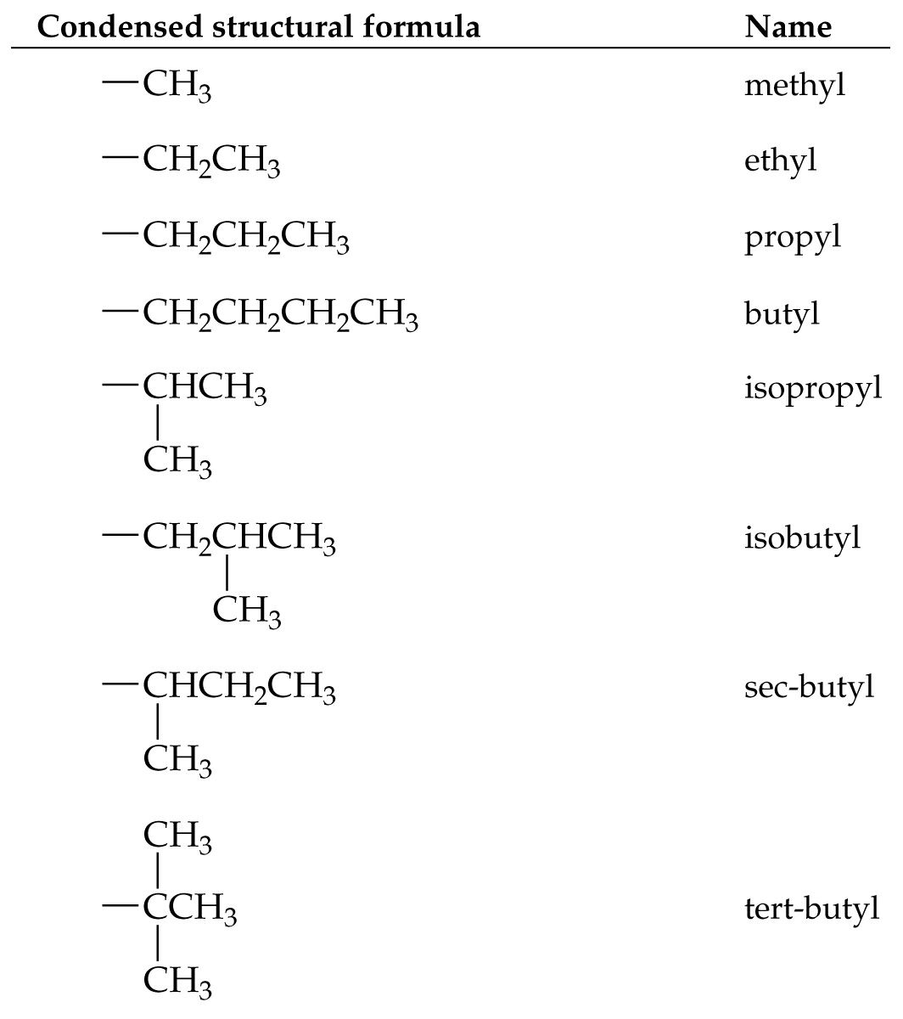
2 carbon group attached to main chain

Slide 12
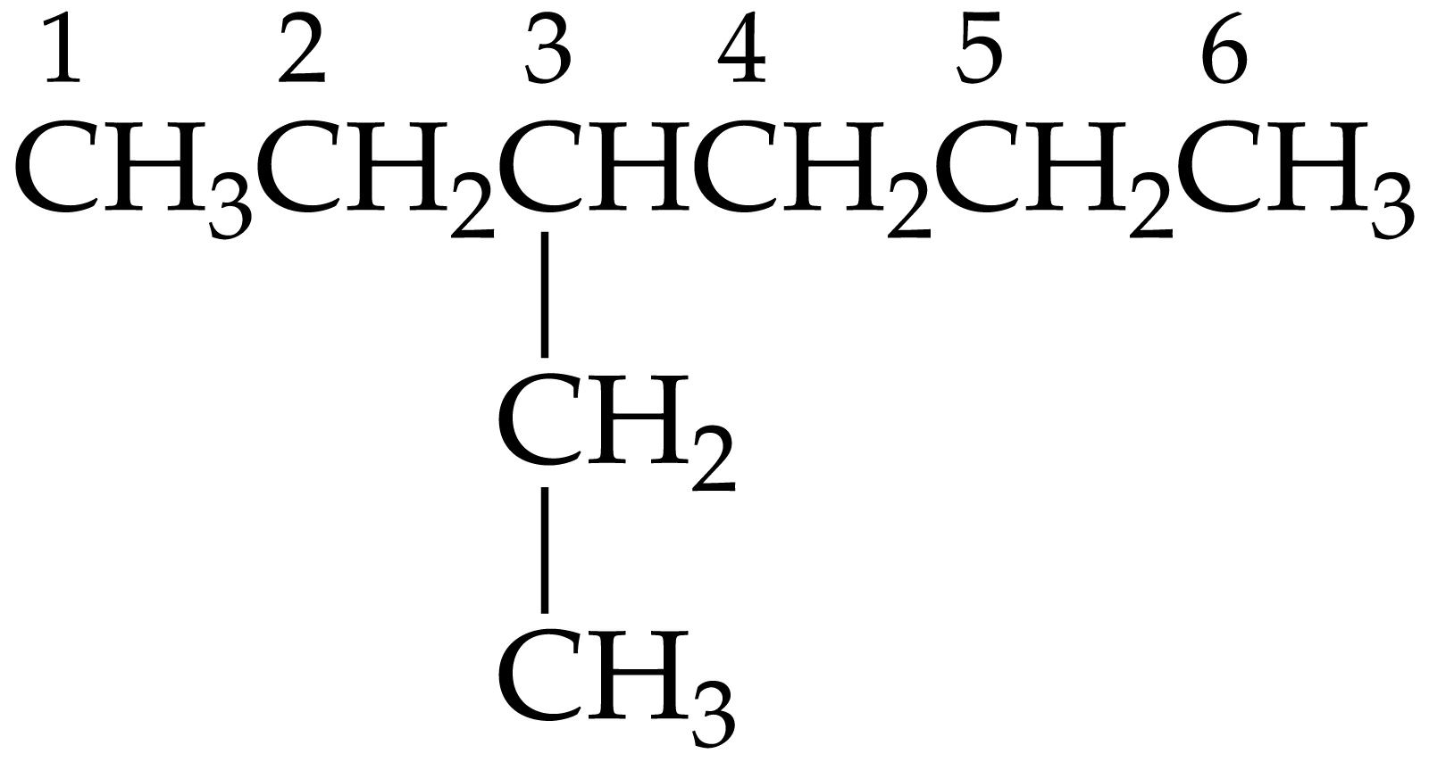
3-ethyl hexane

Slide 13
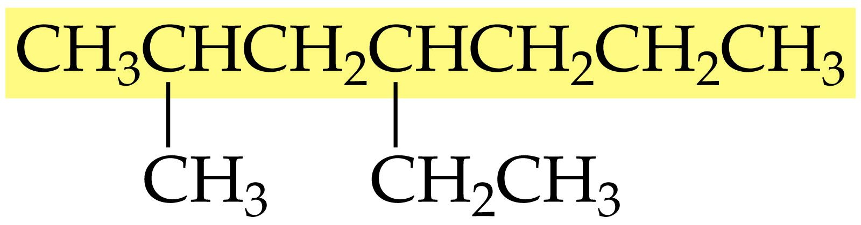
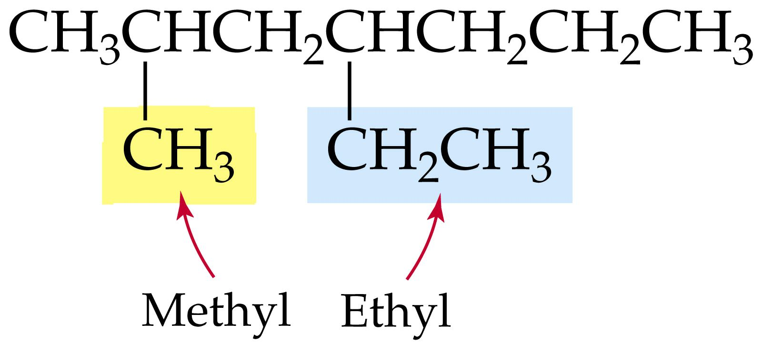

Slide 14
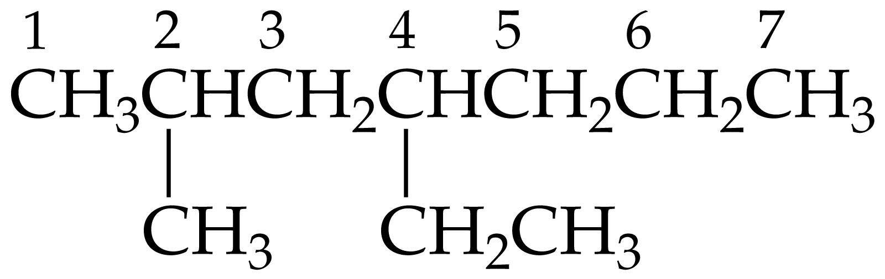
4-ethyl-2-methyl heptane

Slide 15
Cycloalkanes

Slide 16
Physiological Properties of Alkanes
Methane (CH₄) is physiologically inert.
Cyclopropane (C₃H₆) is a safe, effective, and fast acting anesthetic.
Pyrethrins are cyclopropane derivatives found in the pyrethrum daisy which have insecticidal activity. Pyrethrins are frequently used in flea sprays.
Liquid alkanes (gasoline) dissolve and wash away oils.
Solid alkanes are applies to the skin as emollients (skin softeners).

Slide 17
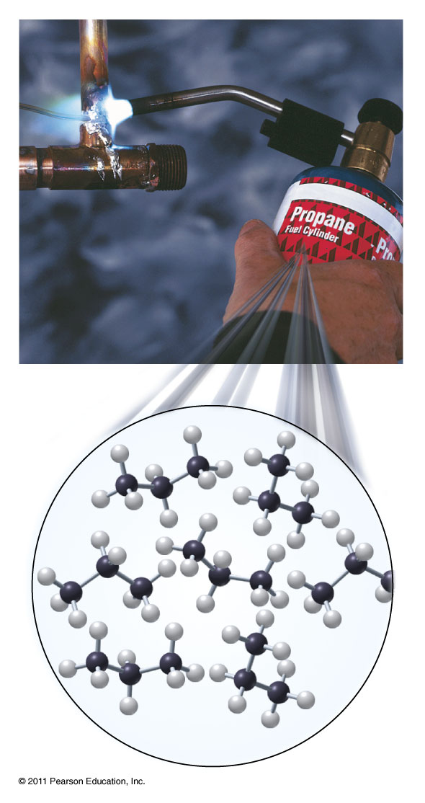
Properties of Alkanes
Methane (CH₄), propane (C₃H₈), and butane(C₄H₁₀) are all used as fuels.
Cyclopropane (C₃H₆) is a safe, effective, and fast acting anesthetic.
Pyrethrins are cyclopropane derivatives found in the pyrethrum daisy which have insecticidal activity. Pyrethrins are frequently used in flea sprays.

Slide 18
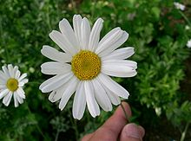
Properties of Alkanes
Cyclopropane (C₃H₆) is a safe, effective, and fast acting anesthetic.
Pyrethrins are cyclopropane derivatives found in the pyrethrum daisy which have insecticidal activity. Pyrethrins are frequently used in flea sprays.

Slide 19
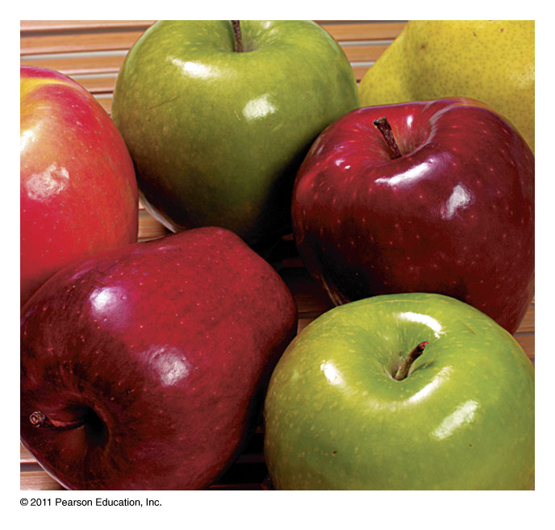
Properties of Alkanes
Liquid alkanes (gasoline) dissolve and wash away oils.
Solid alkanes make up the waxy coating on fruits and vegetables. They are also applied to the skin as emollients (skin softeners).

Slide 20
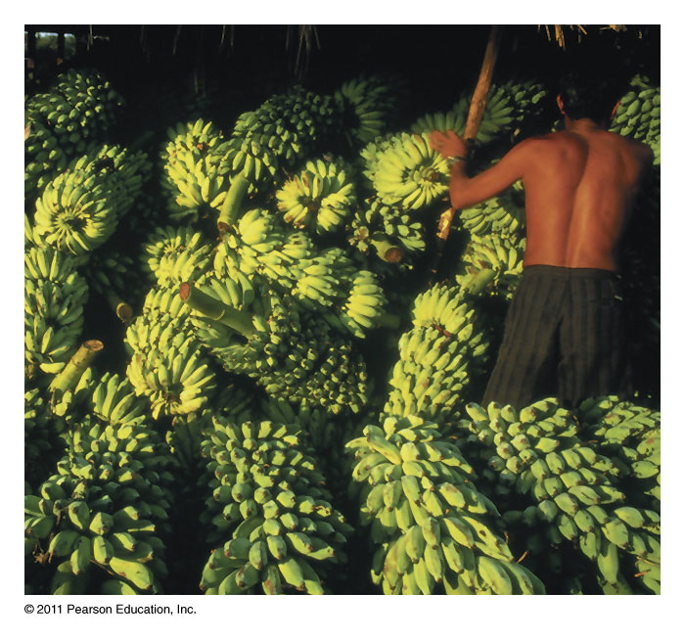
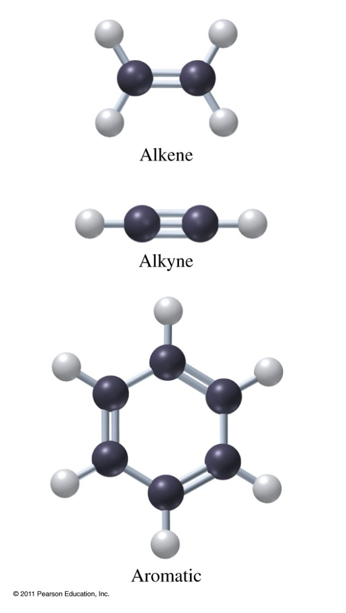
Unsaturated Hydrocarbons
Ethene used to ripen fruit.

Slide 21
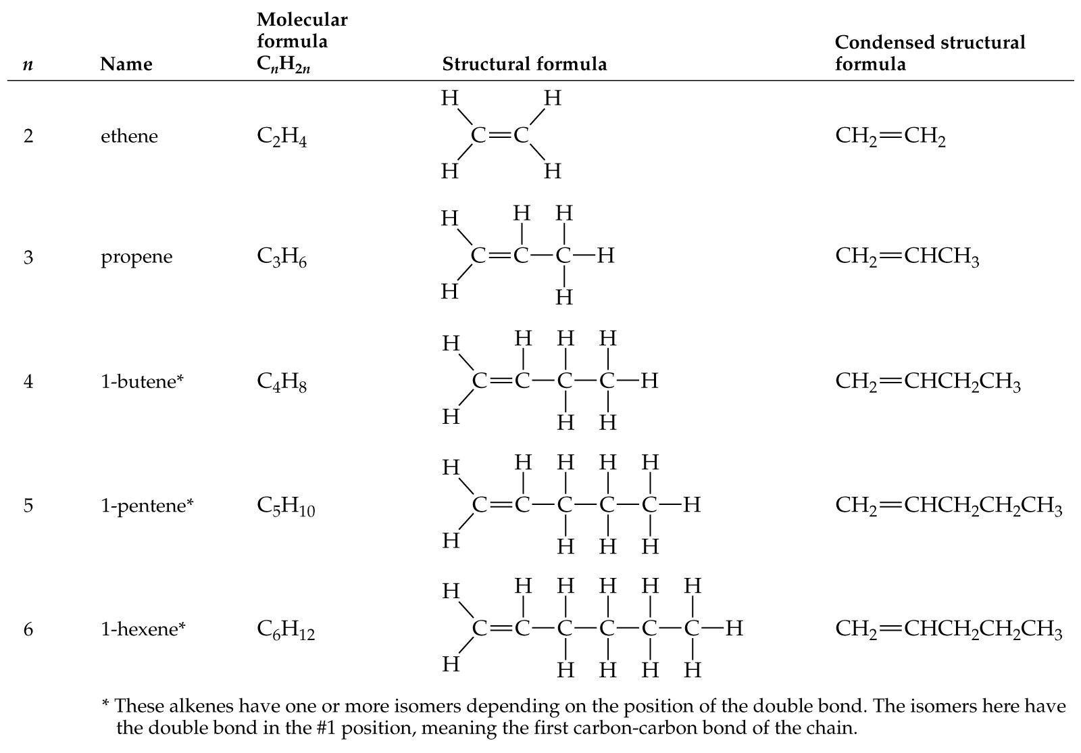
Alkenes – double bonds

Slide 22
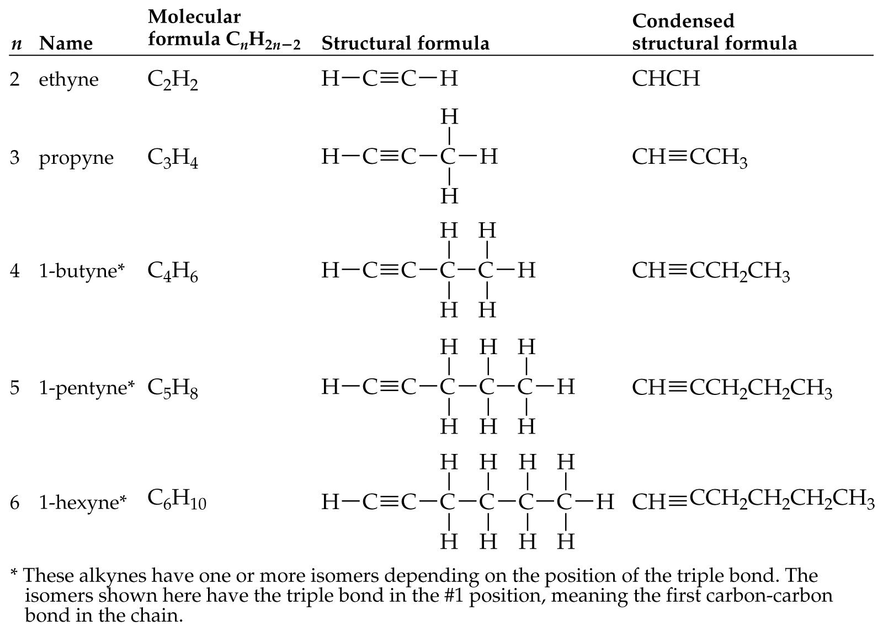
Alkynes – triple bonds

Slide 23
Functional Groups in Organic Compounds
Hydrocarbons
Alcohols and Ethers
Aldehydes and Ketones
Carboxylic acids and Esters
Amines and Amides
Amino Acids

Slide 24
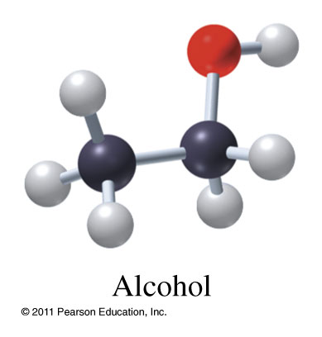
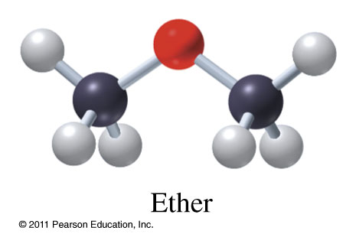
Alcohols and Ethers
Alcohol
  General formula R-OH
Ether
  General formula R-O-R
Methanol CH₃OH
Ethanol CH₃CH₂OH
Dimethyl ether CH₃OCH₃
Diethyl ether CH₃CH₂OCH₂CH₃

Slide 25
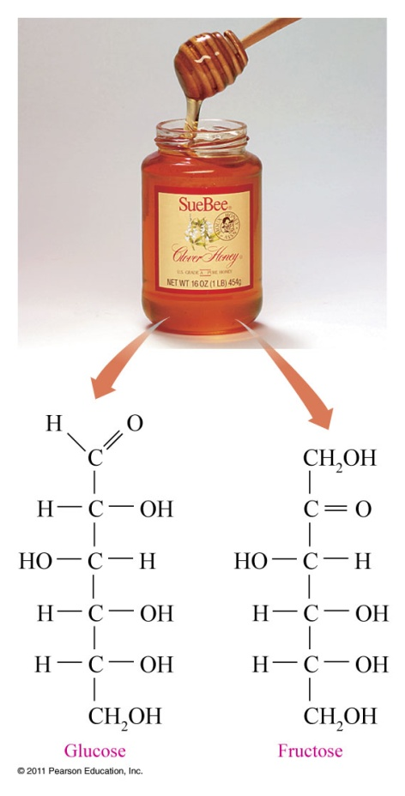
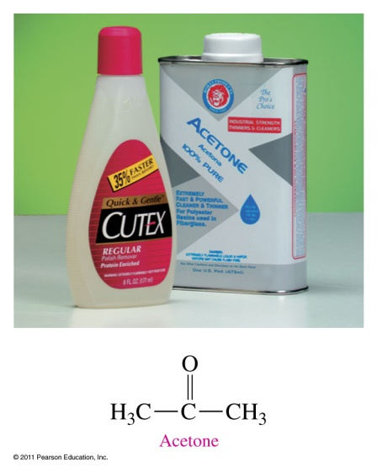
Aldehydes and Ketones
Contain a carbonyl group
Aldehydes
  Carbonyl attached to at least 1 hydrogen
Ketones
  No hydrogen attached to carbonyl.

Slide 26
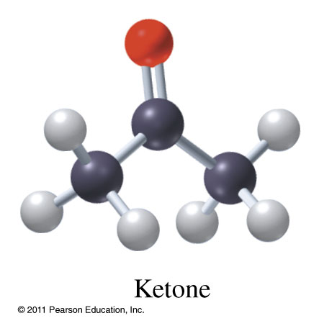
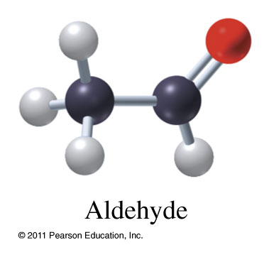
Aldehydes and Ketones
Methanal
Ethanal
Propanone
Butanone

Slide 27
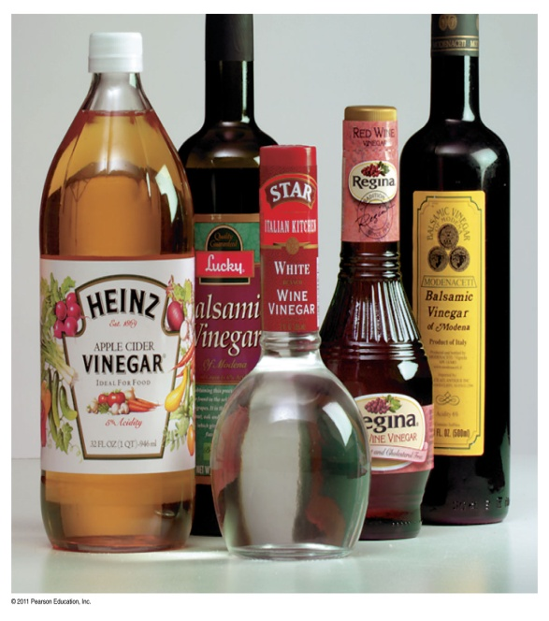
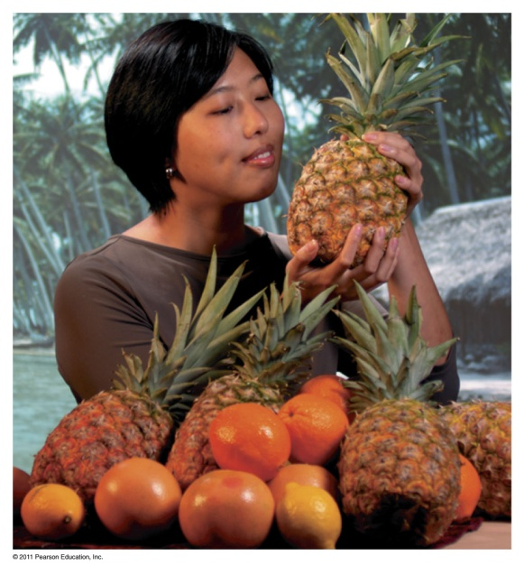
Carboxylic Acids and Esters
Contain a carboxyl group
Carboxylic acid
  Oxygen attached to H
Esters
  Carbon (R) group attached to H

Slide 28
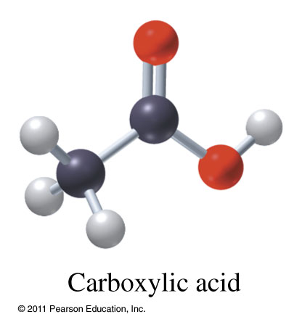
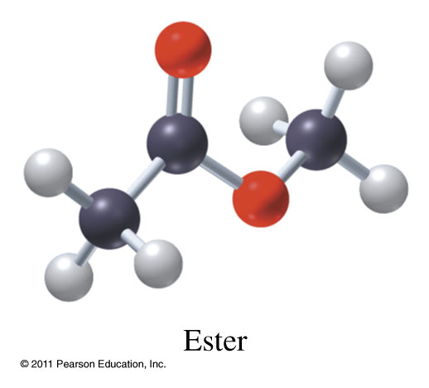
Carboxylic Acids and Esters
Methanoic acid
Ethanoic acid
Methyl methanoate
Methyl ethanoate

Slide 29
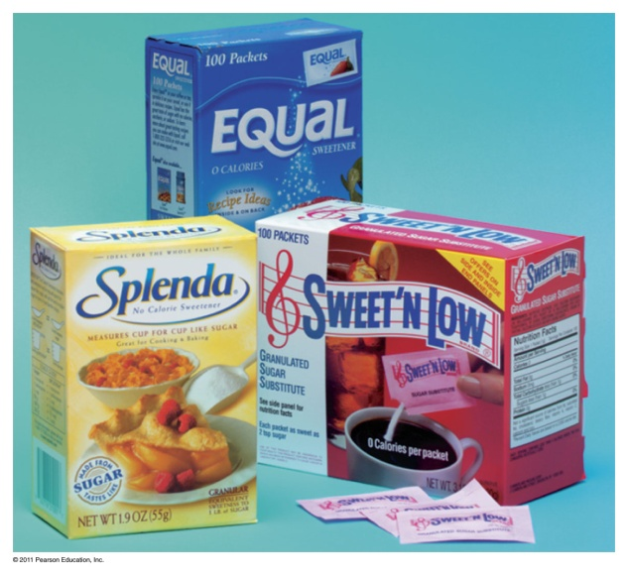
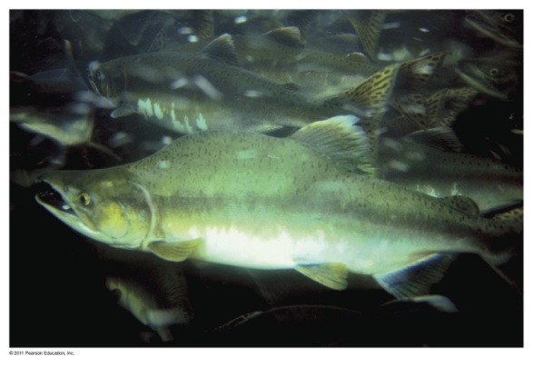
Amines and Amides
Contain nitrogen
Amines
Amides
  Carbonyl attached to a nitrogen

Slide 30
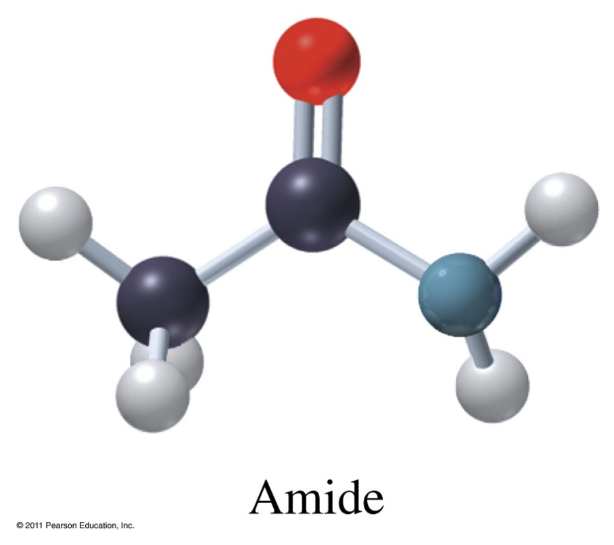
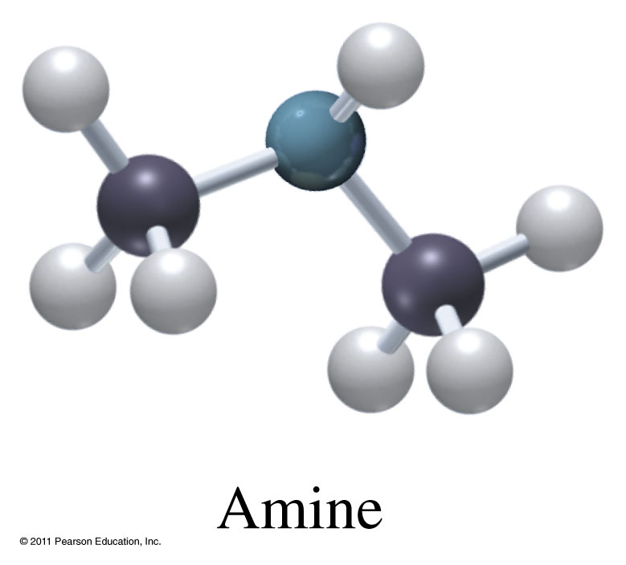
Amines and Amides
Methyl amine
Ethyl amine
Methanamide
Ethanamide
Propanamide

Slide 31
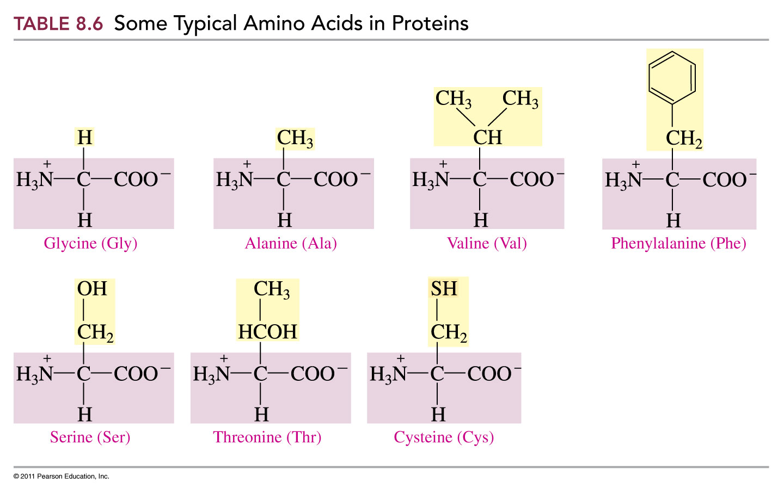
Amino Acids

Slide 32
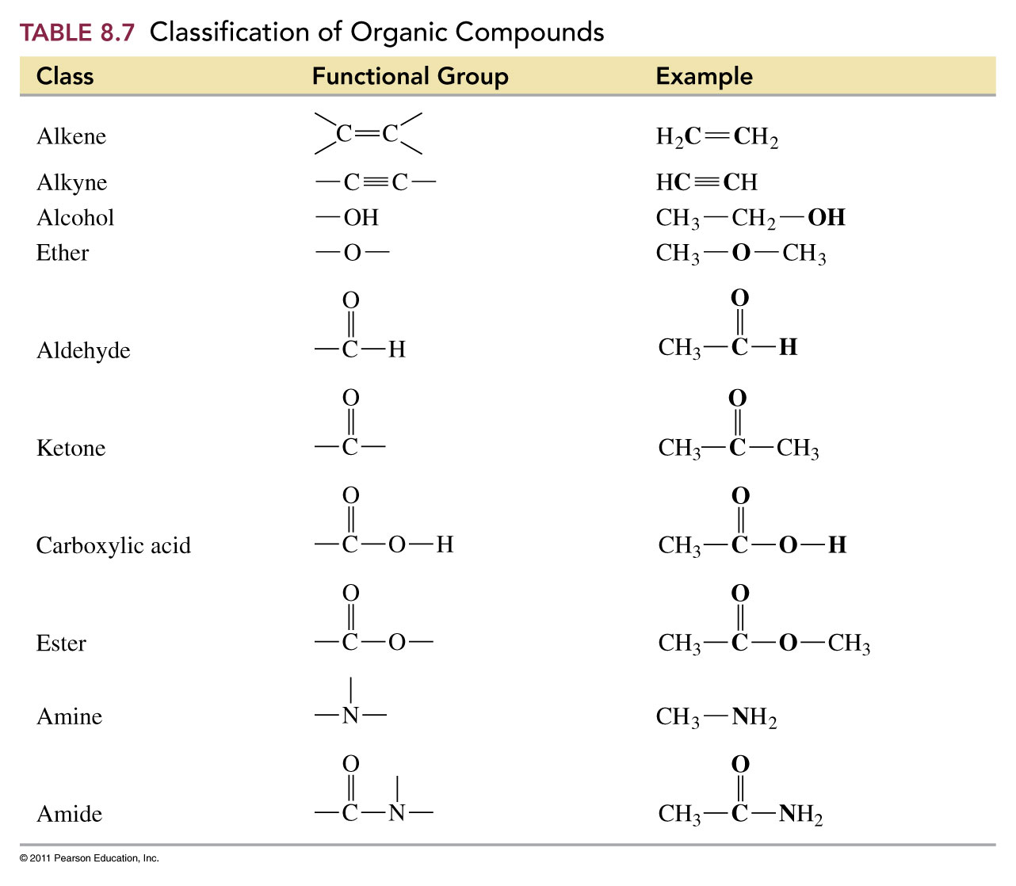

Slide 33
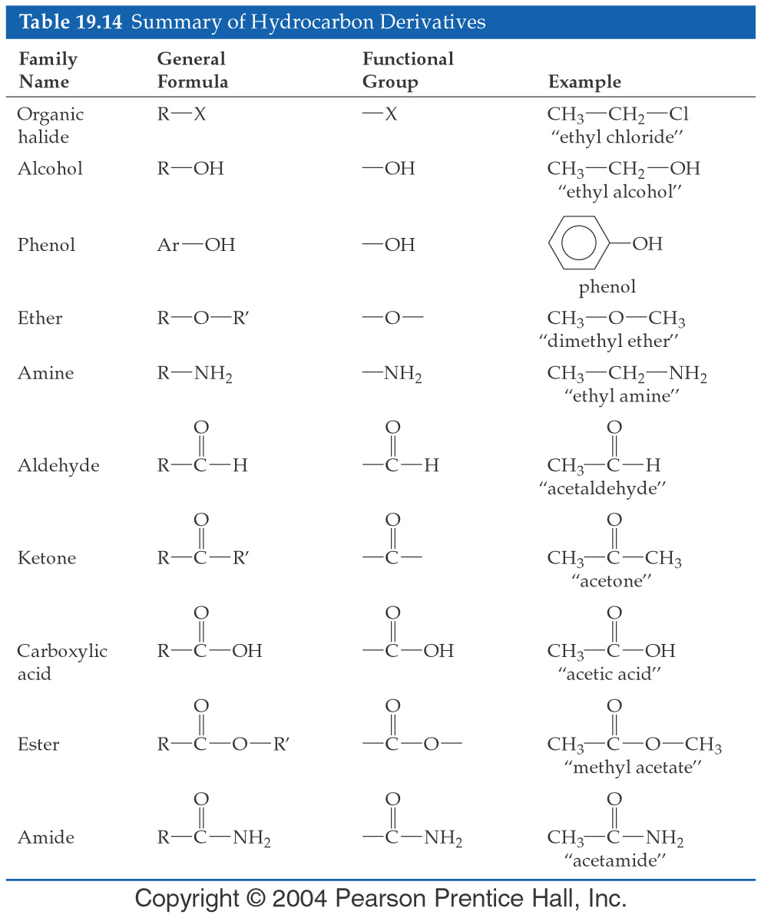

Slide 34
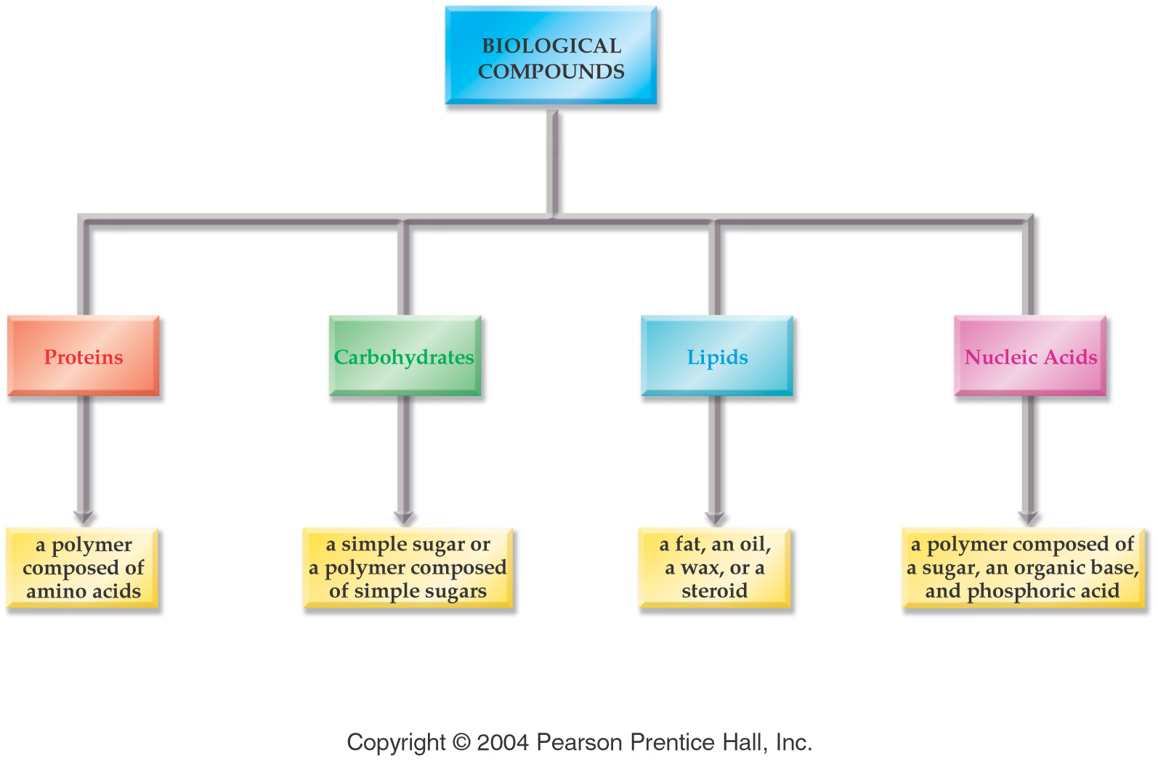

Slide 35
Monosaccharides - Simple carbohydrates that cannot be broken down by hydrolysis
D-(-)-glucose
D-(+)-galactose
D-(+)-mannose
D-(-)-fructose

Slide 36
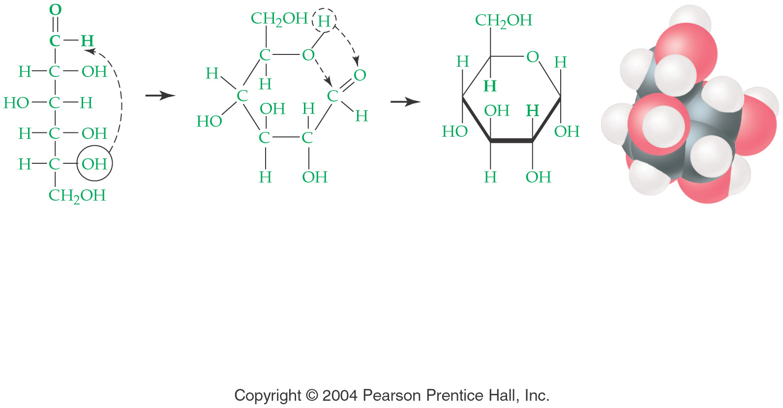
Sugars form a ring in solution

Slide 37
Disaccharides - sugars consisting of 2 monosaccharides
Maltose
Sucrose
Lactose

Slide 38
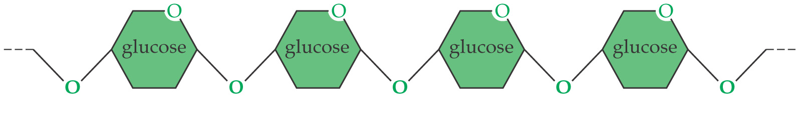
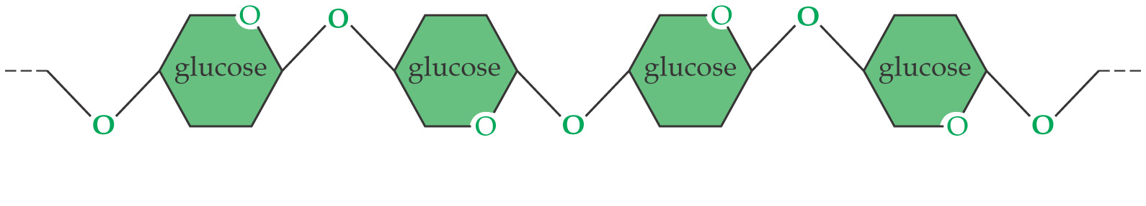
Polysaccharides
starch
cellulose

Slide 39
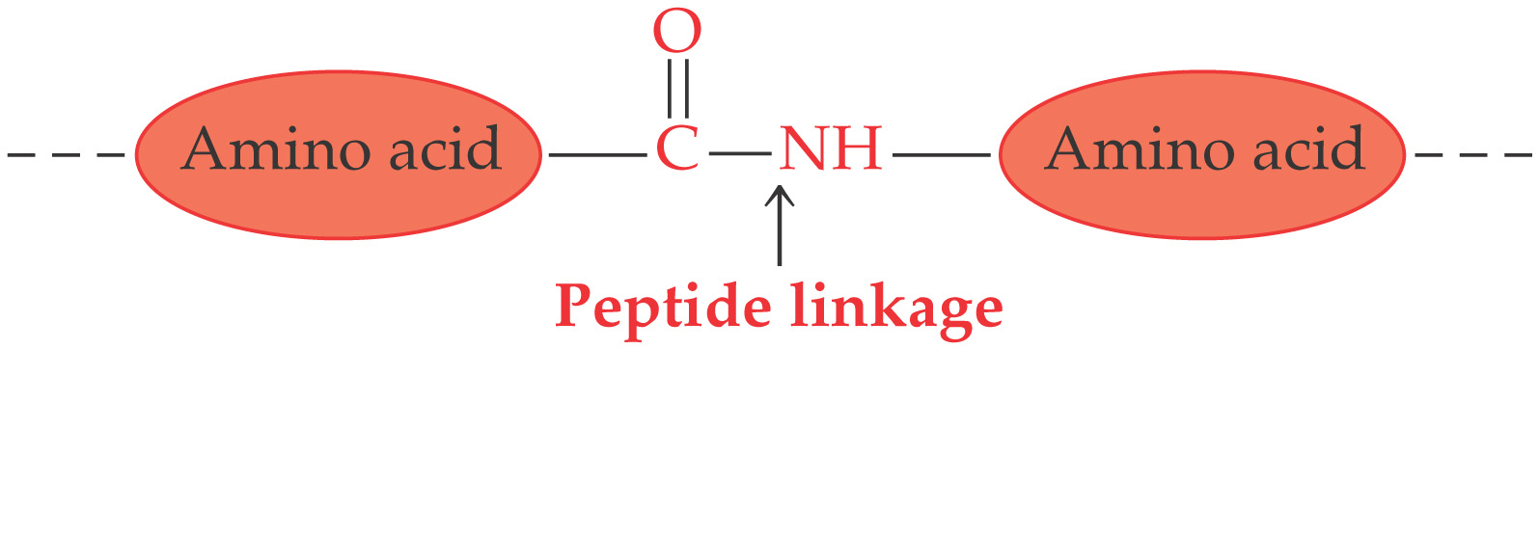
Proteins – composed of amino acid chains

Slide 40
Major Classes of Protein
Fibrous Proteins
  Long rod-shaped or string-like molecules that can intertwine with each other and form strong fibers.
Globular Proteins
  Folded to be spherical

Slide 41
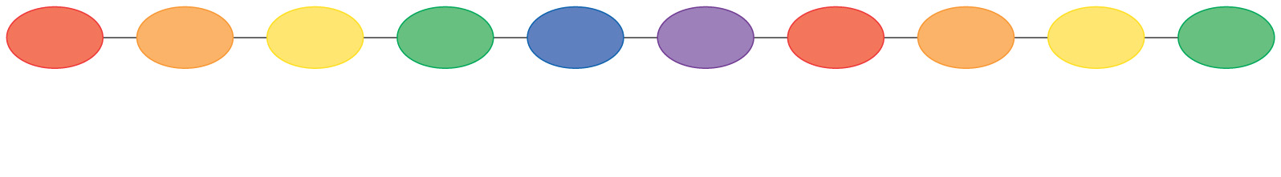
Primary structure
refers to the number and sequence of amino acids in a peptide chain
the unique sequences of each of the proteins determine their shapes and properties

Slide 42
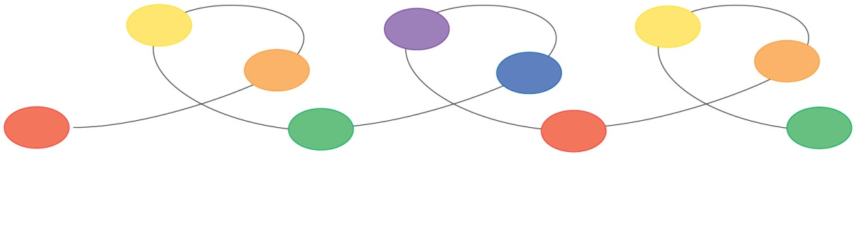
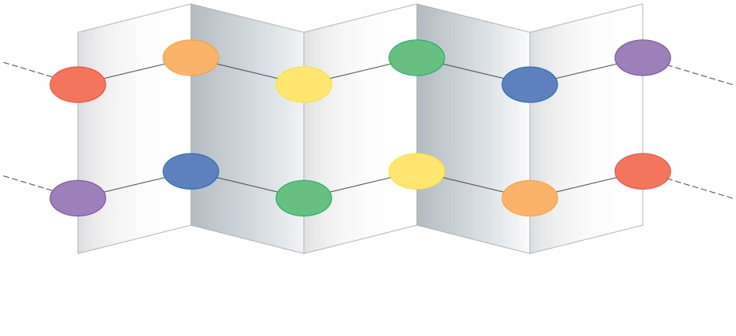
Secondary structure
Refers to the ordered arrangement of the polypeptide backbone.
Alpha helix
Beta sheet

Slide 43
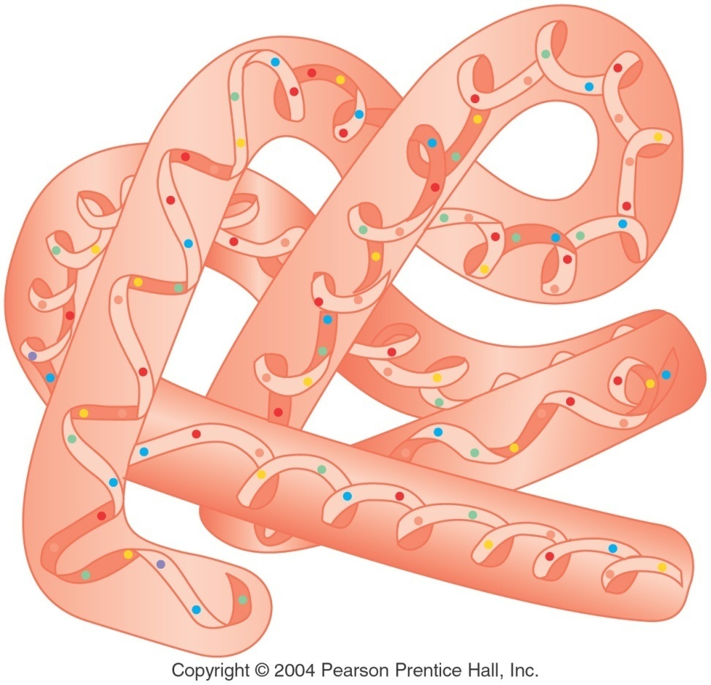
Tertiary structure
Refers to the unique 3-D shape that results from the unique folding of the secondary structure.

Slide 44
Protein Function
Catalytic
Structural
Storage
Protective
Regulatory
Nerve impulse transmission
Motion
Transport

Slide 45
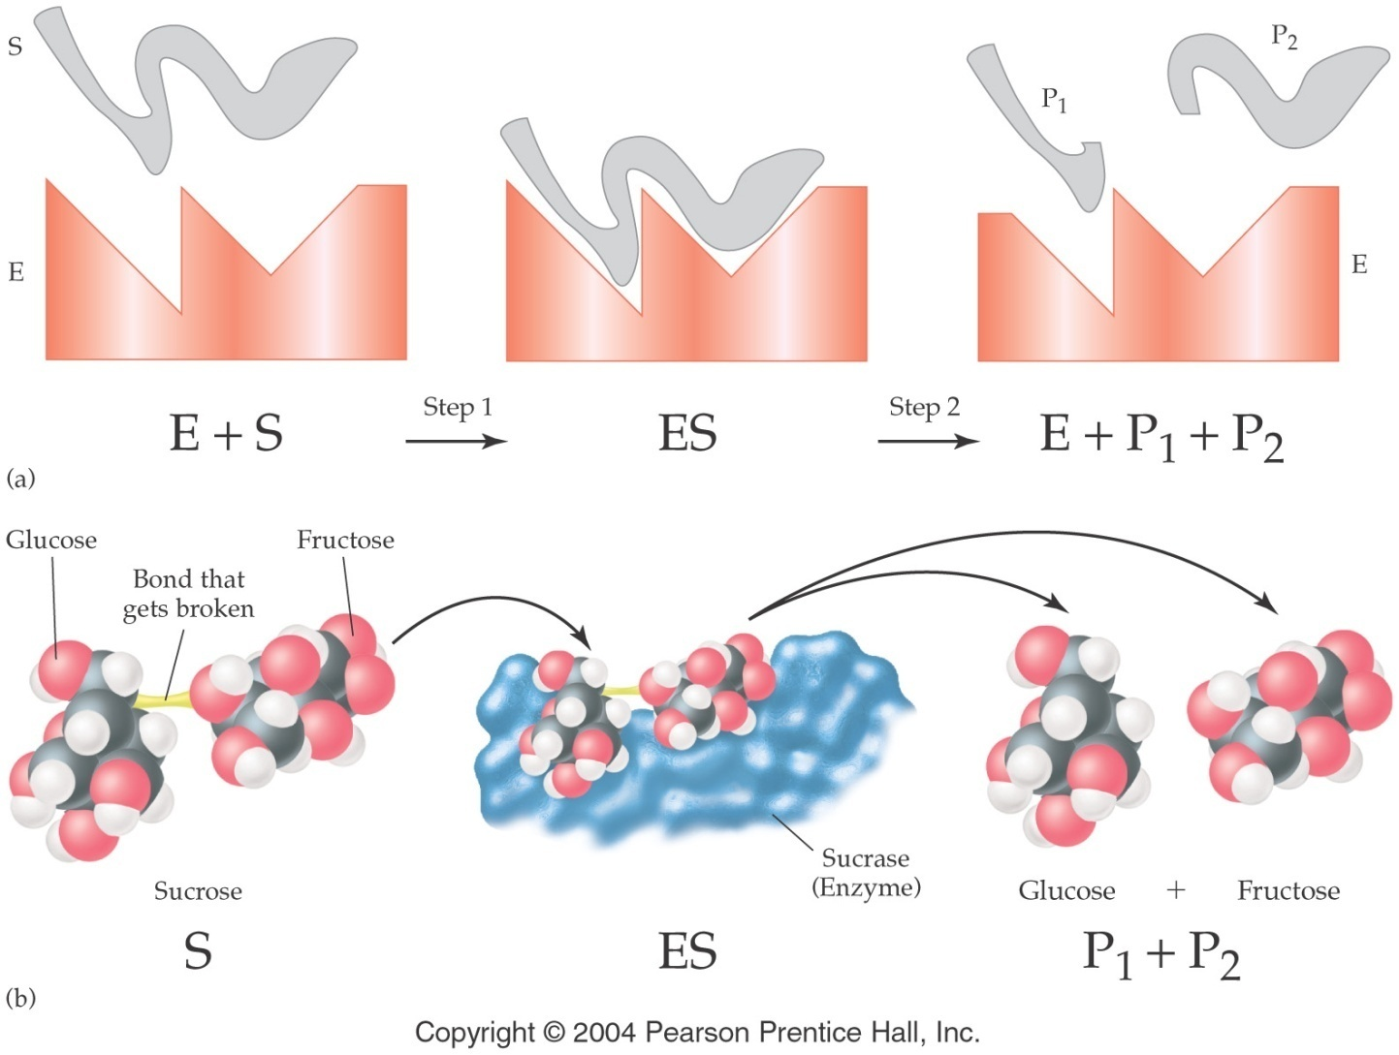
Enzymes

Slide 46
Denaturation of proteins
Denaturation is any process that results in the loss of a proteins native configuration and thus its activity.
Denaturing agents
  Heat and UV light
  Organic solvents
  Strong acids and bases
  Detergents
  Heavy Metals

Slide 47
Lipids
Lipids are biological molecules that are insoluble in water and soluble in organic solvents.
  Saponifiable lipids -- hydrolyzed to form carboxylic acid salts and alcohols.
    tryglycerides
  Nonsaponifiable lipids -- not hydrolyzed
    Cholesterol and steroids

Slide 48
Lipid Function
Energy Storage
  2 X the calories of carbohydrates per gram
Important components of brain and nerve tissue
They store and provide fat soluble vitamins
  (Vitamins A, D, E, and K)
They serve as protective padding and insulation for vital organs.
They are a major constituent of cell membranes.

Slide 49
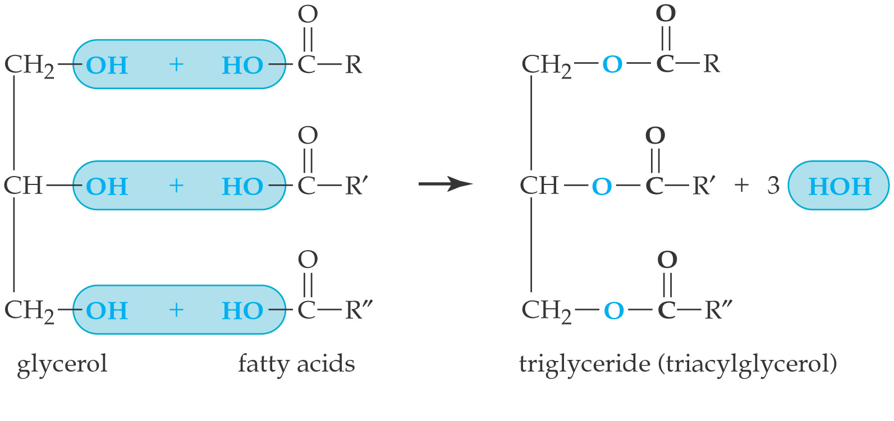
Triglycerides

Slide 50
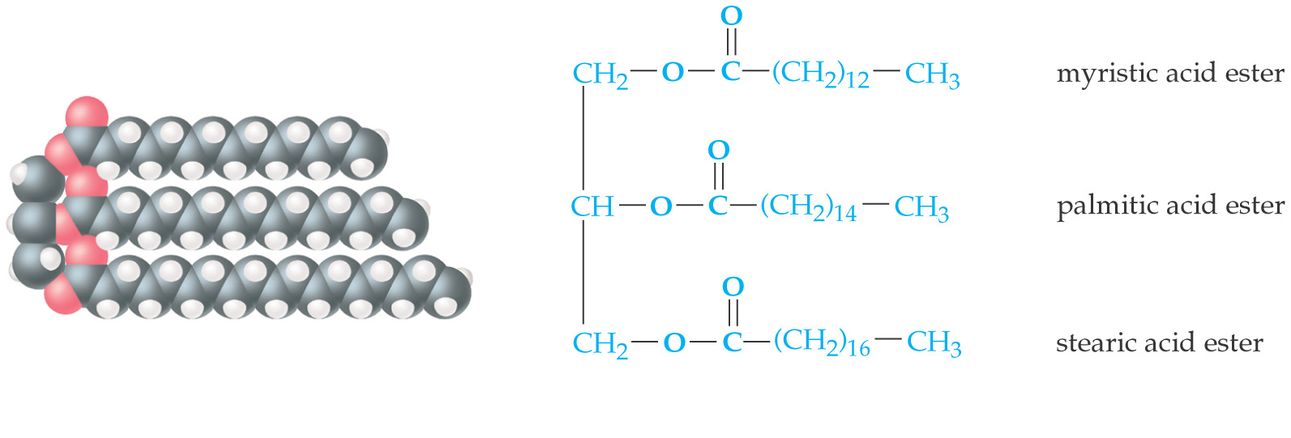
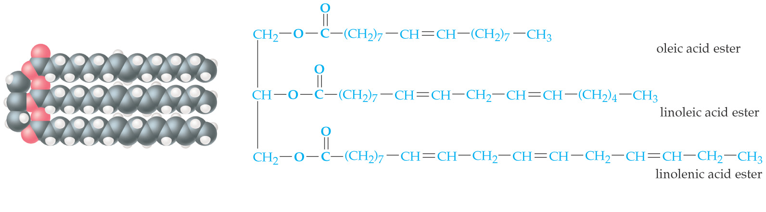
Saturated fat
Unsaturated fat

Slide 51
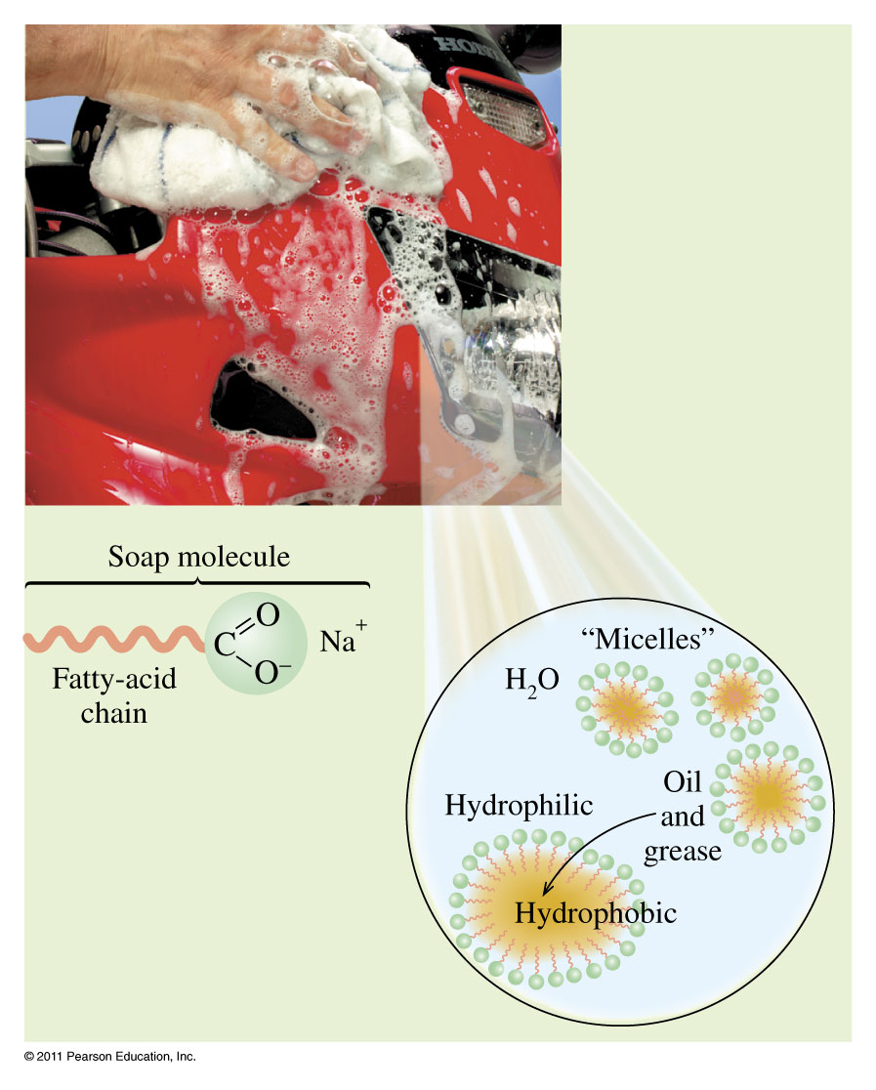

How do soaps work??

Slide 52
Steroids
Cholesterol
  most prevalent steroid
  membrane component
  combines with fatty acids and abnormal muscle tissue in atherosclerosis
  Cholesterol is precursor to other steroids including bile salts, sex hormones, vitamin D, and adrenocortaid hormones.

Slide 53
Nucleic acids
Contain genetic information

Slide 54






Nucleotide
A nucleotide in DNA consists of one of the 4 bases linked to a deoxyribose sugar which is linked to a phosphate:
Adenine deoxyribonucleotide:

Slide 55

DNA
DNA is a polymeric substance made up of thousands of units called nucleotides.
The structure of DNA consists of two polymeric strands of nucleotides in the form of a double helix.
The sequence of base pairs in the DNA is the genetic code for the individual.

Slide 56
RNA
RNA is a single stranded polymer of nucleotides that contains ribose rather than deoxyribose and the base uracil rather than thymine.
The main function of RNA is to direct the synthesis of proteins in the ribosomes of the cell.
Transcription is the process by which DNA directs the synthesis of three types of RNA: messenger RNA, transfer RNA and ribosomal RNA

Slide 57


